Slide 1
Welcome slide

Slide 2
Orchestrating Bedrock Agents for Collaborative Intelligence
Ajay Dhungel

Slide 3
Agenda
01 | Amazon Bedrock and Agents | 05 | AWS resources with terraform
02 | Multi-Agents | 06 | Collaboration in action
03 | Designing multi-agent collaboration | 07 | Conclusion
04 | Building the knowledge base

Slide 4

‹#›
‹#›
Bedrock and Agents
Serverless access to foundation models from leading providers
Bedrock Agents do: Orchestrate workflows, retrieve knowledge, invoke tools.
Agent components: Instruction, knowledge base, action group
Amazon Bedrock
AWS User Groups
AWS User Groups

Slide 5


Knowledge Base
Connects your documents to an agent using semantic search so it can answer questions with real context.
Components
S3 Bucket: Stores your source documents (PDFs, TXT, CSV, etc.)
Embedding Model: Converts text into vector embeddings
OpenSearch Index: Stores those vectors for fast retrieval
Amazon Simple Storage Service (Amazon S3)
Amazon OpenSearch Service

Slide 6
Foundational Models Used
Agents: Amazon Nova Lite
Embedding Model: Amazon Titan Text Embeddings V2

Slide 7

Multi Agent Collaboration.
A way for one agent to delegate tasks to other specialized agents.
Specialized agents tackle tasks under a supervisor agent
Benefits:
Automation of task routing and coordination
Reliable, scalable and adaptive workflow
Effortless orchestration without coding

Slide 8
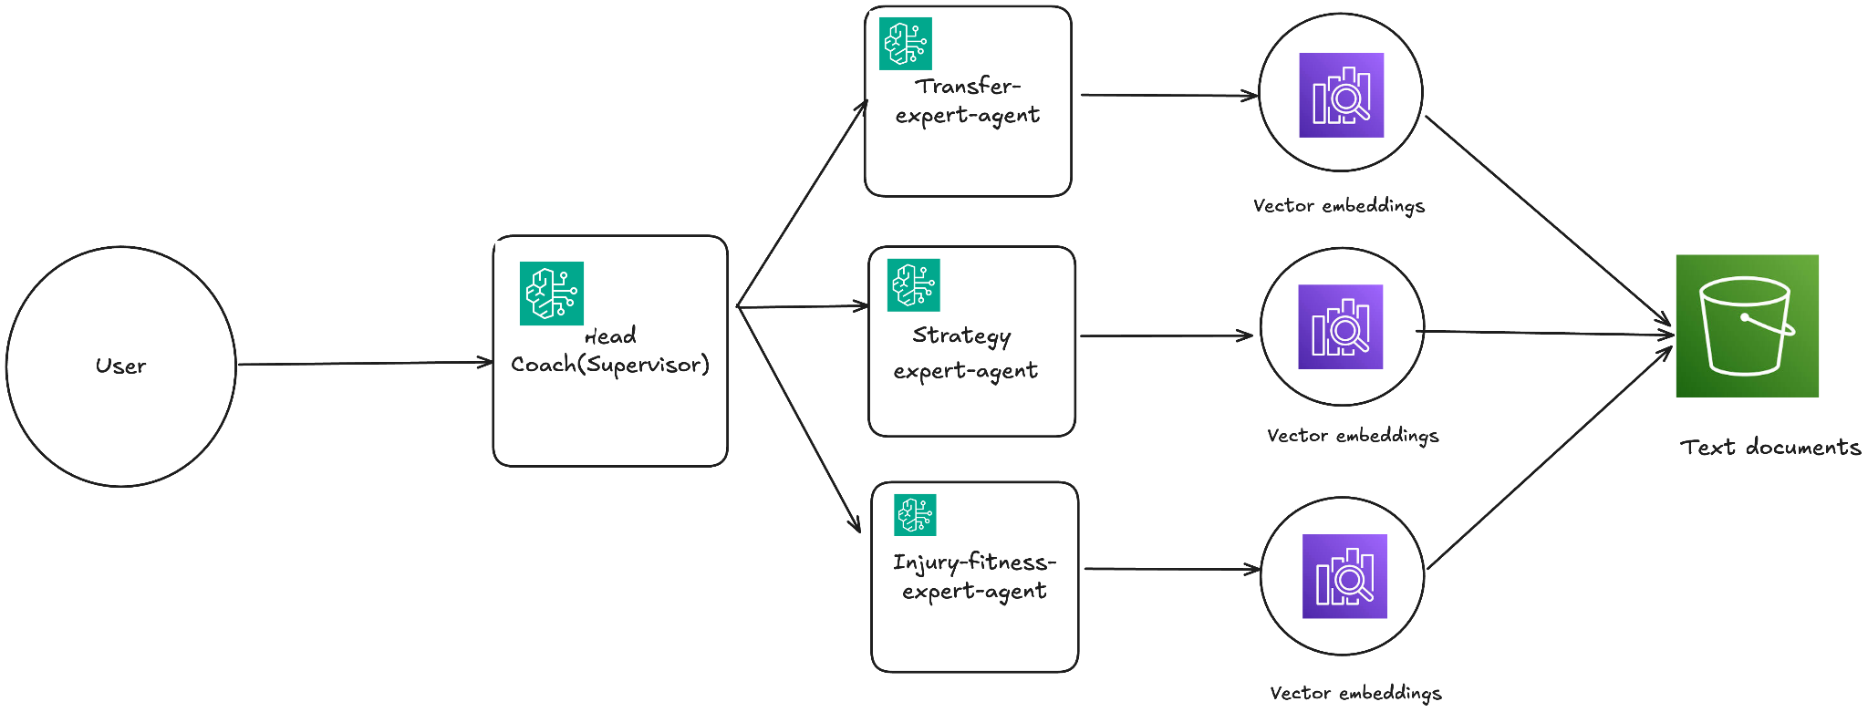
How it works

Slide 9
Head Coach Agent (The Master):
The entrypoint for user and orchestrator for all customer interactions.Captures the query, determines the intent, routes request to the appropriate specialized agent.
Transfer Market Agent:
Handles all transfer-related inquiries; analyzes player valuations, market trends, contract details, and club negotiations. Delivers insights based on current and historical transfer data retrieved from its specialized knowledge base.

Slide 10
Strategy Agent:
Focuses on tactical and performance analysis; interprets formations, game strategies, player roles, and opponent behaviors. Provides strategic recommendations grounded in expert-level football knowledge and historical match data.
Injury and Fitness Agent
Manages fitness-related insights; evaluates player injury status, recovery timelines, workload management, and rotation planning. Offers actionable advice rooted in medical and performance data from its dedicated knowledge source.

Slide 11
Instructions to each Agent (Prompt Engineering):
Head Coach:
“Your job is to act as the entrypoint for all user queries.
You must determine the user's intent and route the request to the most suitable specialized agent.”
Transfer Market Agent
“Your job is to analyze football transfer market activity.
Base your answers on your knowledge base and provide insights on player valuations, transfers, and club strategies using human-like responses."

Slide 12
Instructions to each Agent (Prompt Engineering):
Strategy Agent:
“Your job is to evaluate football tactics, formations, and strategic decisions.
Use your knowledge base to provide expert recommendations without quoting data directly; explain like a human scout would.”
Injury and fitness agent:
“Your job is to assess player injuries, fitness levels, and rotation needs.
Use only the knowledge retrieved from your dedicated knowledge base and respond with professional, human-like advice.

Slide 13
Roles of each agent in brief:
• Head Coach: Oversees flow, delegates tasks.
• Assistants: Specialize in strategy, transfers, scouting, etc.
Think of the Head Coach like a project manager distributing subtasks.

Slide 14
Alias
• Different Versions of Agents with different configurations
• E.g: agent:version 1, agent2:version 2

Slide 15
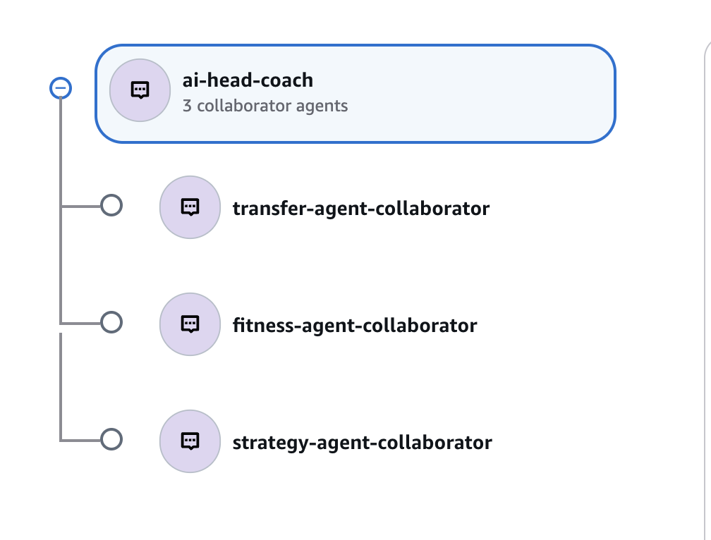
Collaborators

Slide 16
Configure > Prepare > Deploy
Configure:
Make changes to your agent.
Prepare:
Validate and setup access to linked resources like Lambda and Knowledge base
Deploy:
Create an alias to publish the latest version of the agent.

Slide 17
Core Terraform resources to build this setup:
aws_bedrockagent_agent
aws_bedrockagent_knowledge_base
aws_opensearchserverless_collection
opensearch_index
aws_bedrockagent_agent_collaborator
aws_bedrockagent_agent_alias
aws_bedrockagent_agent_knowledge_base_association

Slide 18
Things to Consider
Knowledge Base Isolation
Ensure each agent only accesses its dedicated vector index to avoid cross-domain responses.
Clear Instructions Per Agent:
Explicit, role-specific instructions improve accuracy and reduce generic outputs.
Delegation Logic
Head Coach must reliably identify intent and route to the correct agent.
Fallback & Error Handling
Define behavior when an agent lacks relevant information or fails to retrieve context.
Scalability
Design for adding new agents or domains without disrupting existing workflows.
Testing & Evaluation
Continuously validate agent responses against real user queries to fine-tune performance.

Slide 19
Conclusion
Clear orchestration with a Head Coach agent
Domain expertise through specialized agents
Accurate, context-aware responses
Modular and scalable design
Real-world use case potential

Slide 20
Demo Slides incoming:

Slide 21
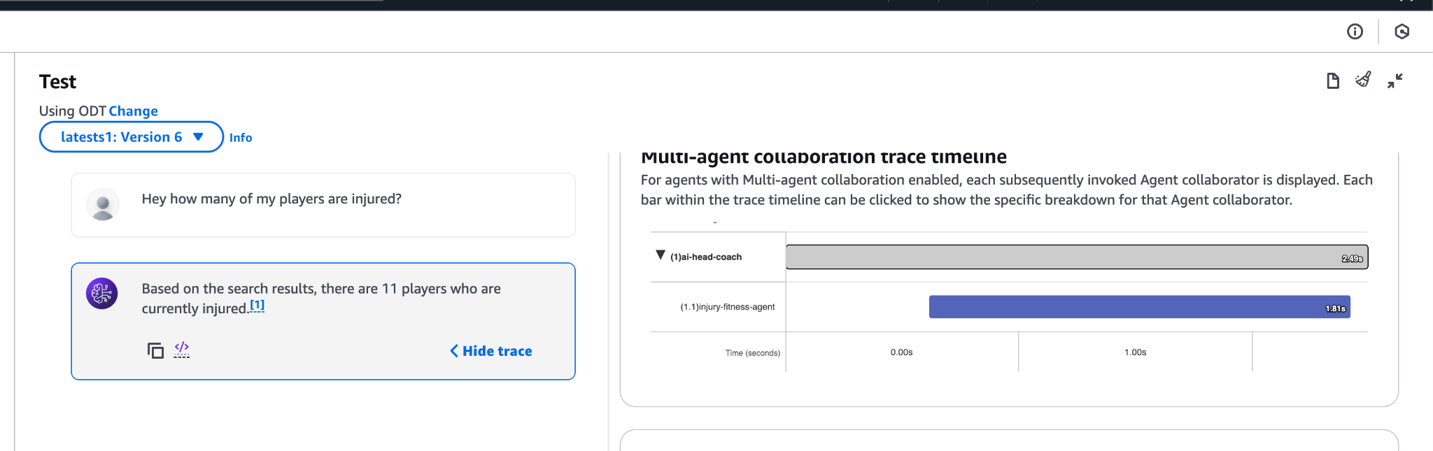

Slide 22
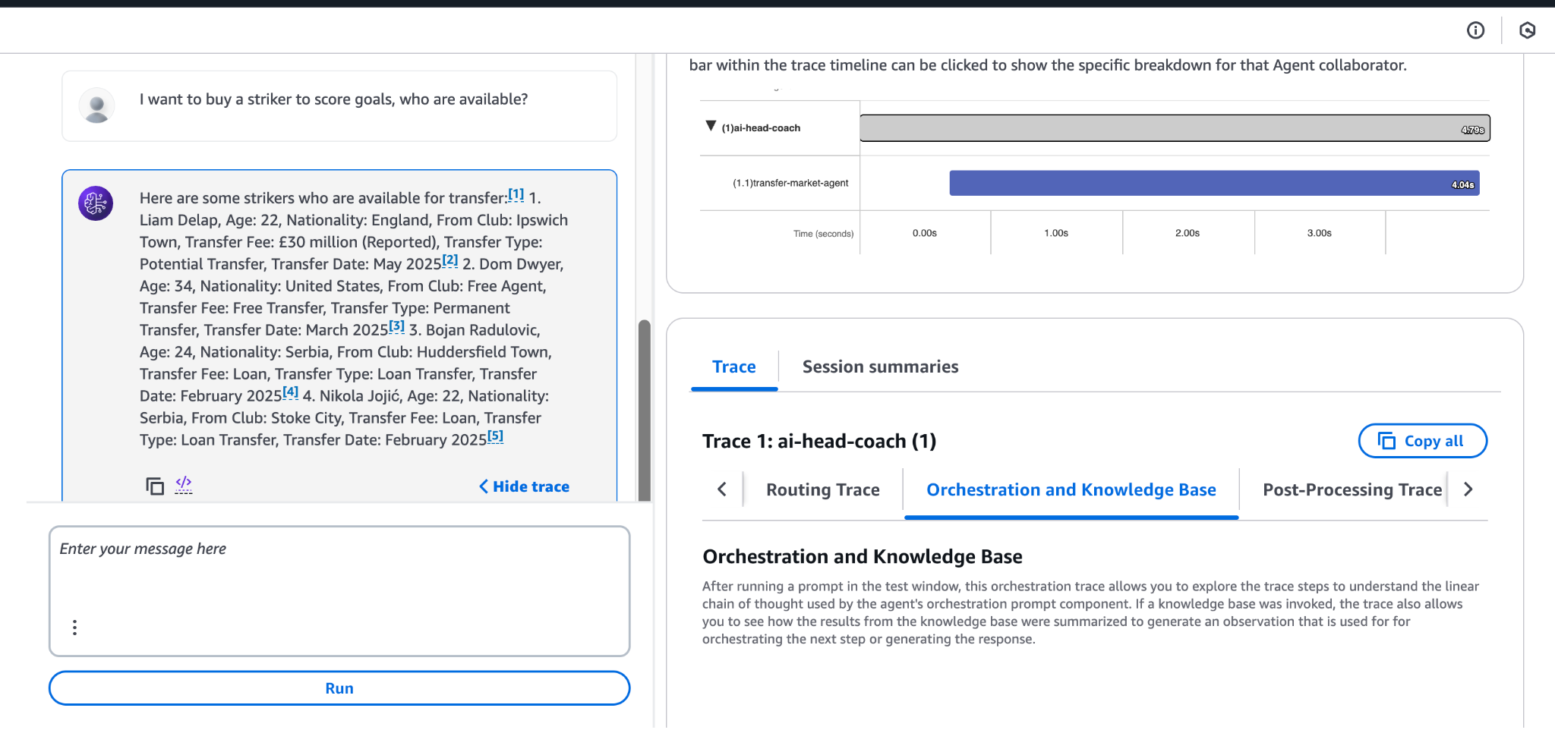

Slide 23
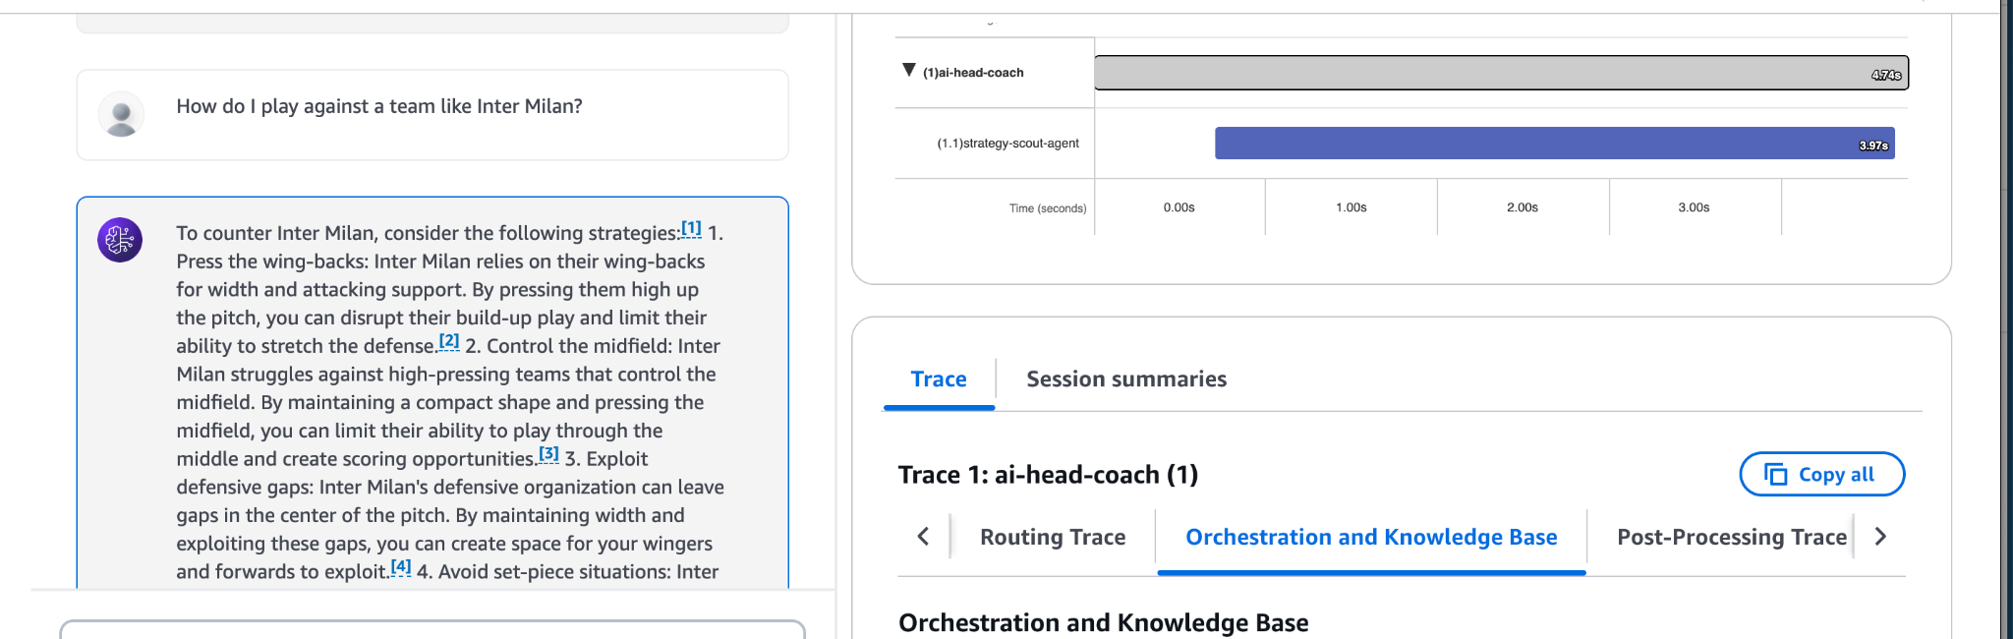

Slide 24
Thank you

