Slide 1


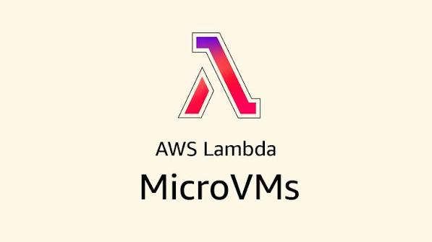

Presented by :
Ajay Dhungel
AWS Lambda MicroVMs:
From Zero to Running

Slide 2


What is MicroVMS?
  A new capability in AWS Lambda, not an upgrade or replacement
  Lambda Functions run on Firecracker VMs behind the hood
  MicroVMs bring that same Firecracker VMs to the surface.
  We can now have control over them, its no more request and response only.
  Minimal and lightweight, compared to traditional Virtual Machines.

Slide 3


MicroVM vs Traditional VM
MicroVM
Traditional VM
  No BIOS: minimal boot loader
  Minimal: network, disk, console
  Boot time: 125ms
  Full BIOS/UEFI
  Full emulation : graphics, USB, legacy
  Boot time: Seconds to minute

Slide 4
Why MicroVM?
Because its Isolated, fast, and allows session persistence. Perfect for AI coding assistants.
Virtual machines
Containers
Lambda Functions
Strong isolation, yet too slow to start.
fast, but share a kernel and unsafe for untrusted code
fast and isolated, but stateless and capped at 15 minutes

Slide 5
Package
Dockerfile + code → zip → S3
Lambda builds the image
Fast,
but how?
The
image-then-launch
Model
runs your Dockerfile, boots the app
Snapshot taken
memory, disk, and running processes, captured once the app is live
Launch
every MicroVM after that starts from the snapshot, not from scratch
Result
2 seconds to run and serve traffic

Slide 6

Where it fits !
01
AI coding assistants
02
Interactive dev environments / notebooks
one dedicated environment per user, so untrusted AI-generated code stays contained
session survives idle time, no reload needed
03
Security & vulnerability scanning
04
Multi-tenant CI/CD
one isolated build per tenant, no shared kernel risk
isolated blast radius per scan

Slide 7
States of MicroVMs
Pending
Running
Suspended
Terminated
The MicroVM is being restored from its snapshot, right after you call run-microvm.
It's live and serving traffic, and this is where compute charges apply.
Idle timeout or an explicit call froze it here; memory and disk stay exactly as they were, and you're only paying for storage.
Gone for good, either by explicit call or the 8-hour cap, with all charges stopped.

Slide 8
Demo !
  Deploys IAM roles and an S3 artifact bucket via CloudFormation
  Builds a custom MicroVM image from a Dockerfile (Python + Flask `/exec` server)
  Launches a MicroVM with `ALL_INGRESS` + `INTERNET_EGRESS` network connectors
  Generates scoped auth tokens and sends HTTPS requests to the MicroVM's `/exec` endpoint
  Installs packages (numpy) and runs Python scripts inside the MicroVM
  Suspends, resumes, and terminates the MicroVM

Slide 9



Presented by :
Ajay Dhungel
Thank You
+1 437-870-6261
ajaydhungel.blog
for your time and attention
dhungelajay@gmail.com
linkedin.com/in/ajaydhungel/

